Slide 1
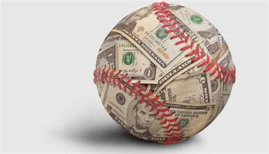
What are the most influential variables to determine baseball arbitration salary?
Tom Bash and Conor Keating
DS300
5/4/21

Slide 2

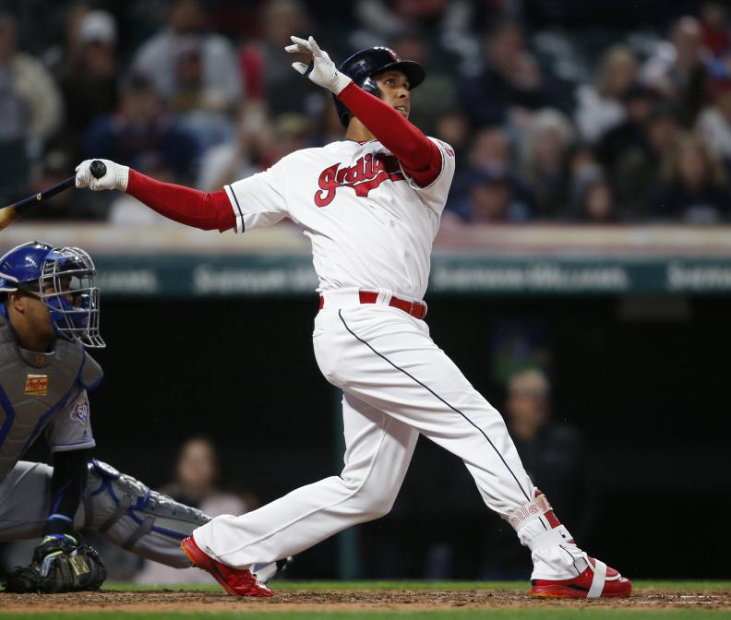
Research Question
And Variables used
What are the most important and influential variables when trying to predict a Major League Baseball position players’ first year arbitration salary?
Variables used: On base % (OBP), Home Runs (HR), Runs Batted In (RBI), Runs (R) , Slugging % (SLG), On Base + Slugging Pct (OPS), Plate Appearances (PA), and Batting Average (BA), Stolen Bases (SB) Strikeout Pct. (Kper/K%), Walk Pct. (BBper/BB%), and Defensive Runs Saved (DRS)

Slide 3
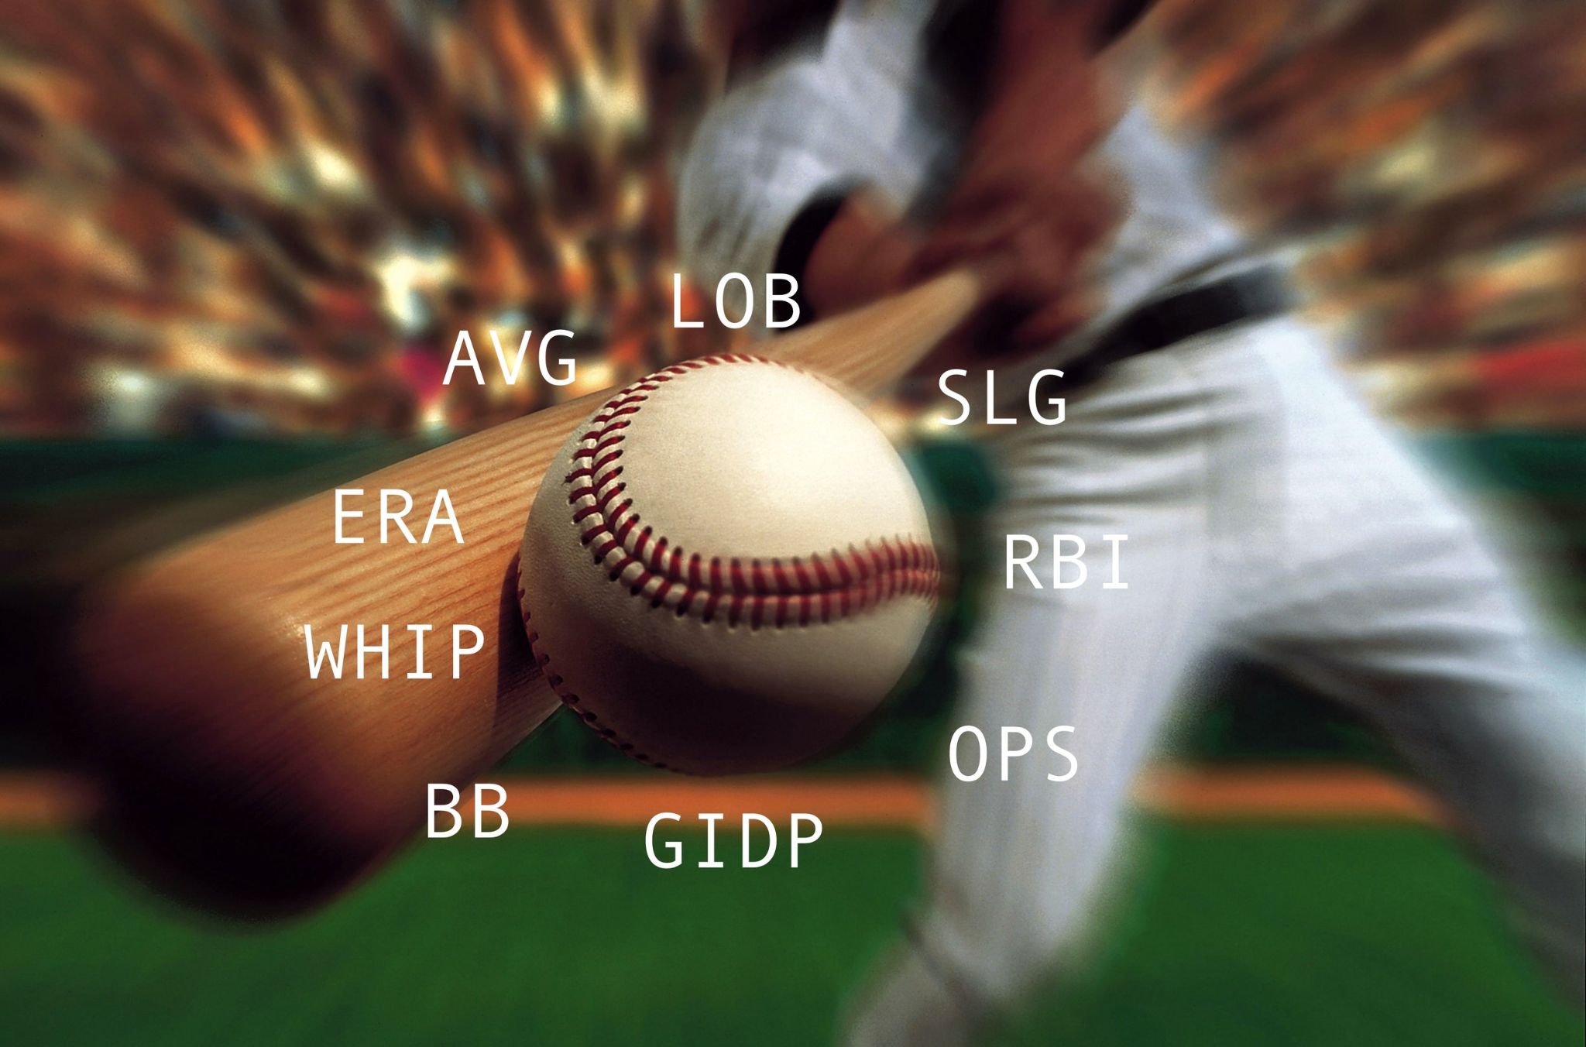
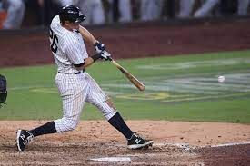
Important Information
Batting Average (BA) = Hits / At Bats
On Base Percentage (OBP) = (Hits + Walks + Hit By Pitches) / Plate Appearances
Home Runs (HR)
Includes over the fence and inside the park home runs
Runs Batted In (RBI)
Runs Scored (R)
Slugging Percentage (SLG)
= # of Singles + (2*(# of Doubles)) + (3*(# of Triples)) + (4*(# of Home Runs)) / (At Bats)
On Base + Slugging Percentage (OPS) = OBP + SLG
Stolen Bases (SB)
Plate Appearances (PA)
Strikeout Percentage (K%, Kper in R) = Strikeouts / PA
Walk Percentage (BB%, BBper in R) = Walks / PA
Defensive Runs Saved (DRS)
The number of runs above or below average the player was worth based on the number of plays made

Slide 4
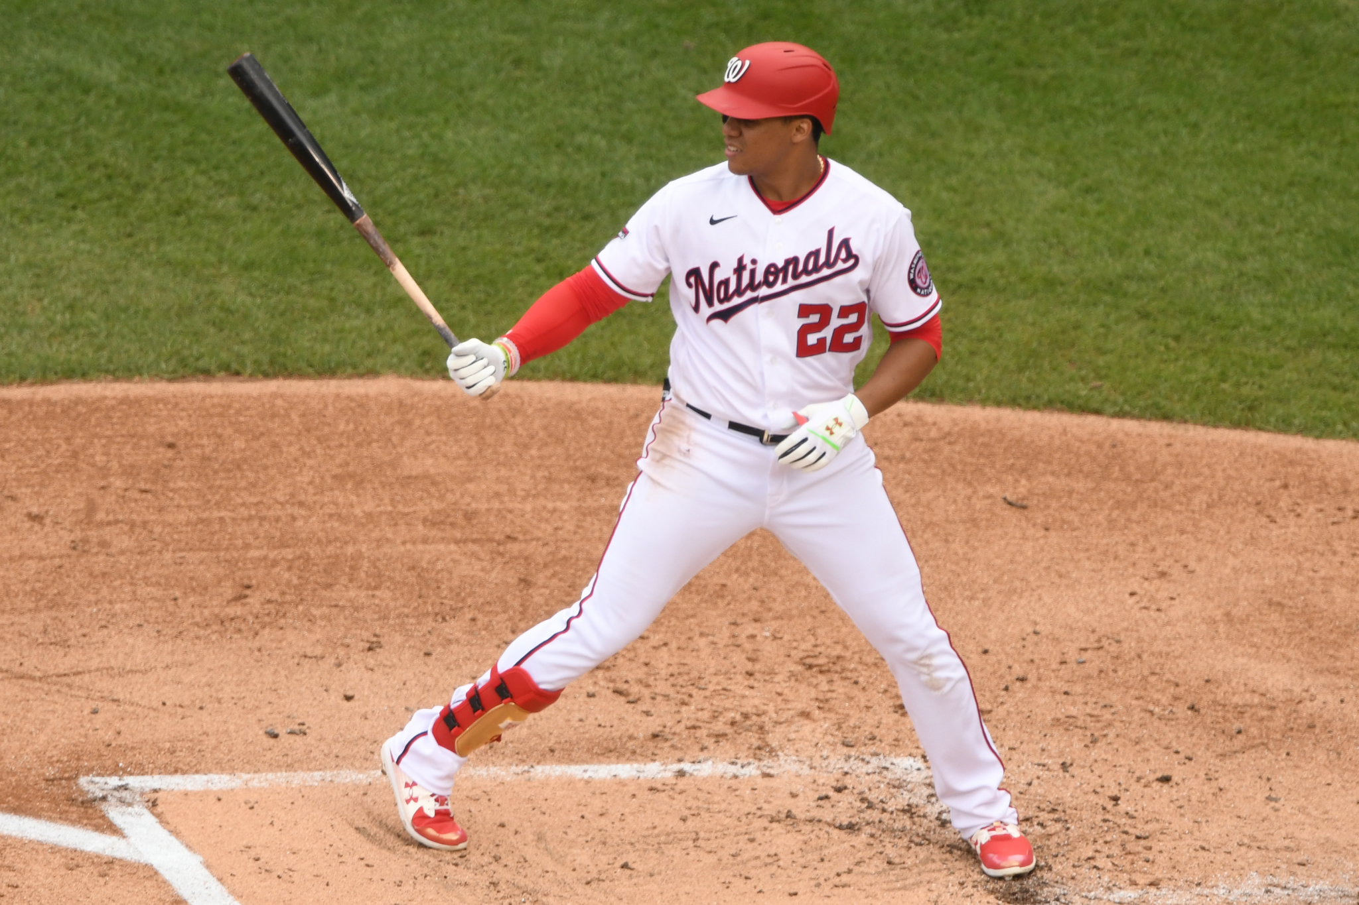
Important Information
MLB teams generally have 6 years of control over each player when they first make the Major Leagues
Players receive "Service Time" for being on the MLB 26-man roster
Players have no negotiating power when determining salary in years 1 and 2
Players are eligible for salary arbitration between years 3 and 6
Players and teams negotiate to try and agree on a dollar amount
If teams and players cannot agree, an independent panel will determine the player's salary for the year
Our data set includes the reported salaries from
first year arbitration eligible players from 2017-2021

Slide 5
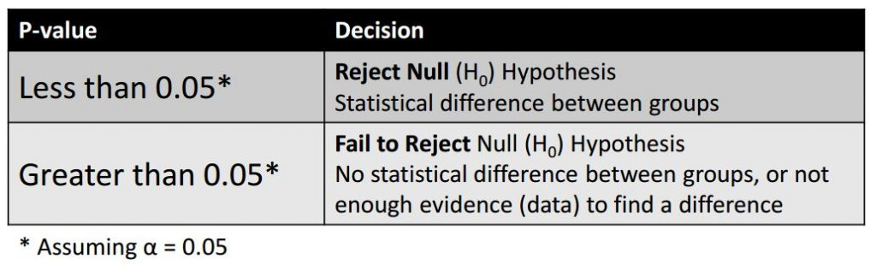
How were these variables determined?
We started out with about 25 variables and after performing data analysis for each one of them (using regression analysis) and comparing the p-values and correlation coefficients for each one, we determined the variables listed in the previous slide were the best for our model.
Highest correlation (r) and adjusted R^2
Lowest p-values, which signifies a significant linear relationship
Used a 95% confidence level, therefore alpha=.05

Slide 6
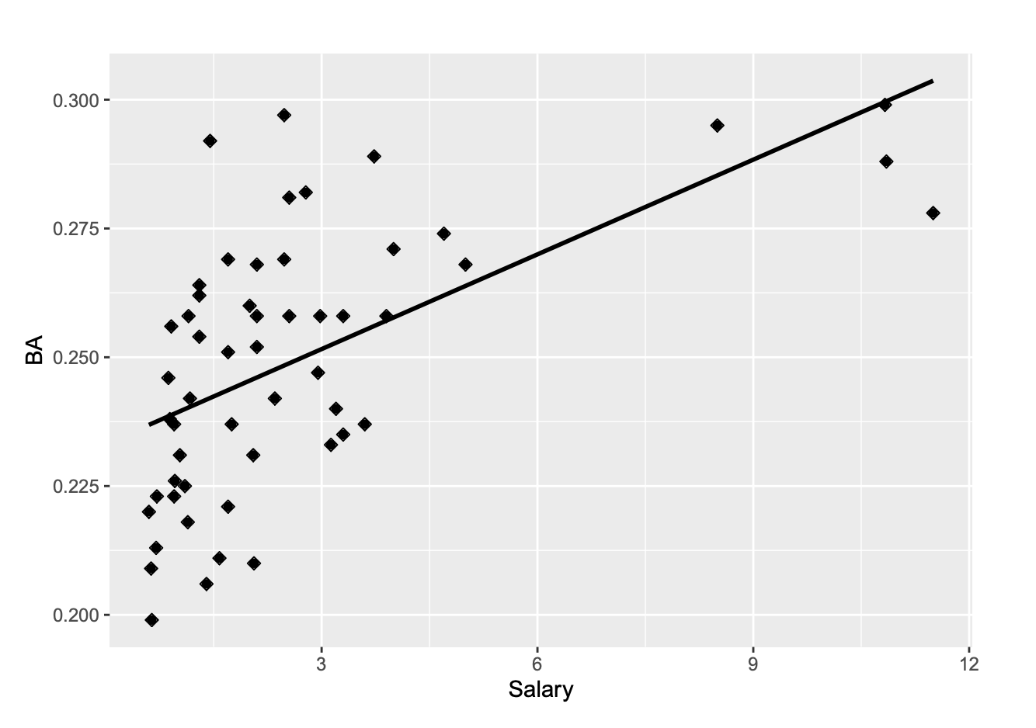
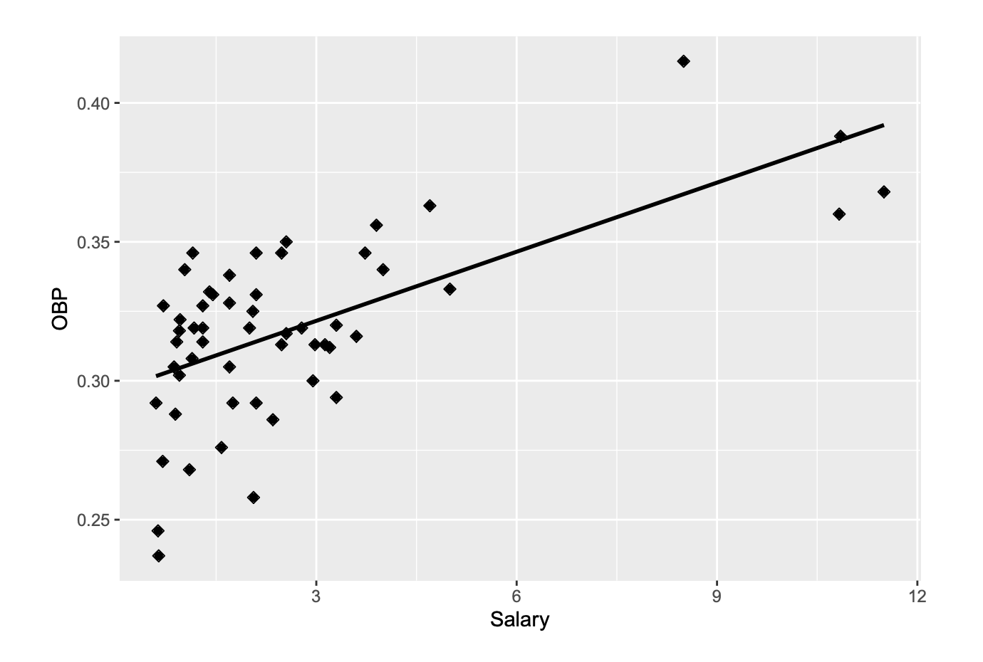
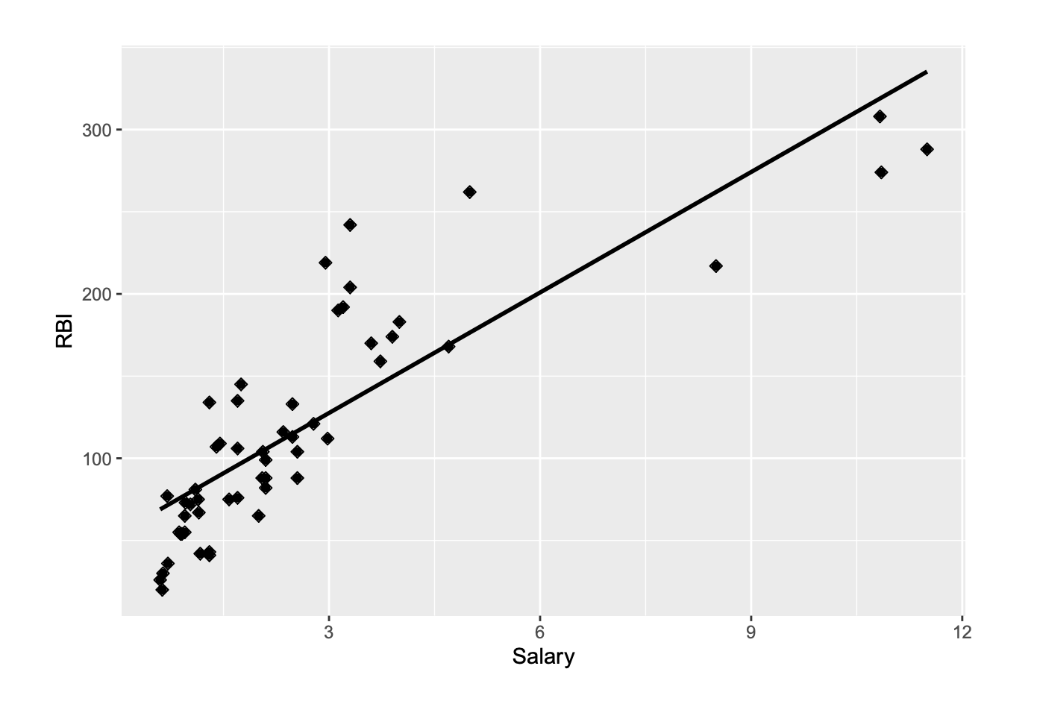
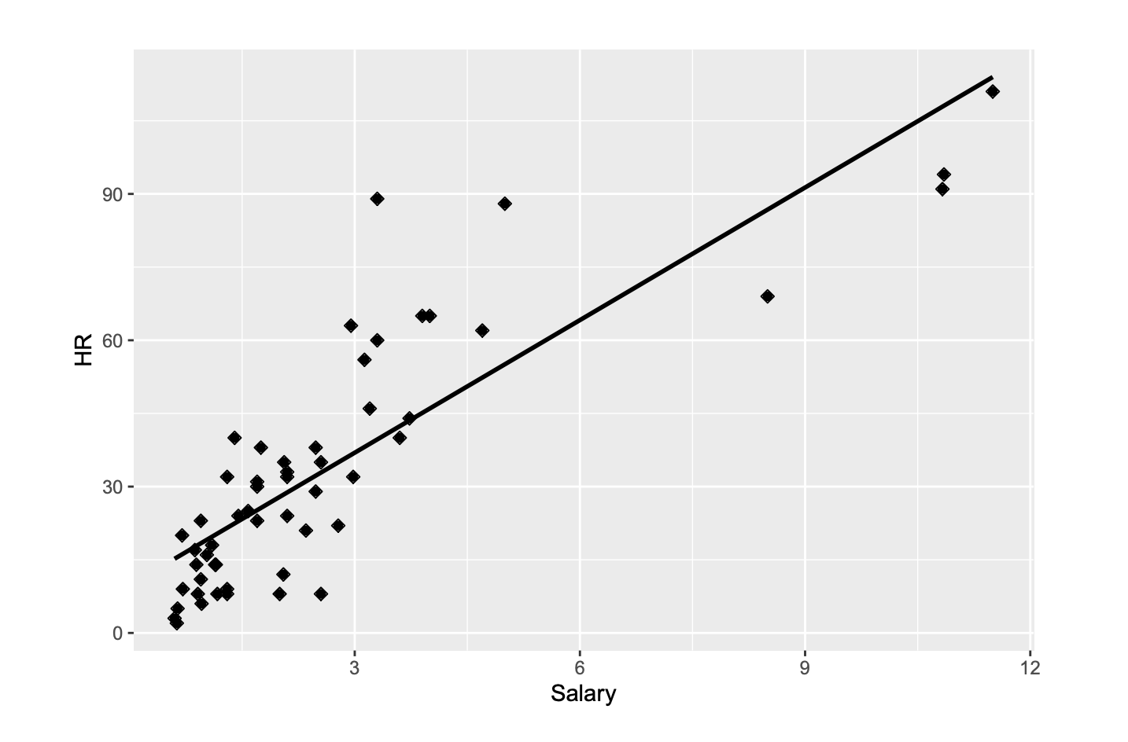
Salary vs...
BA OBP
HR RBI

Slide 7
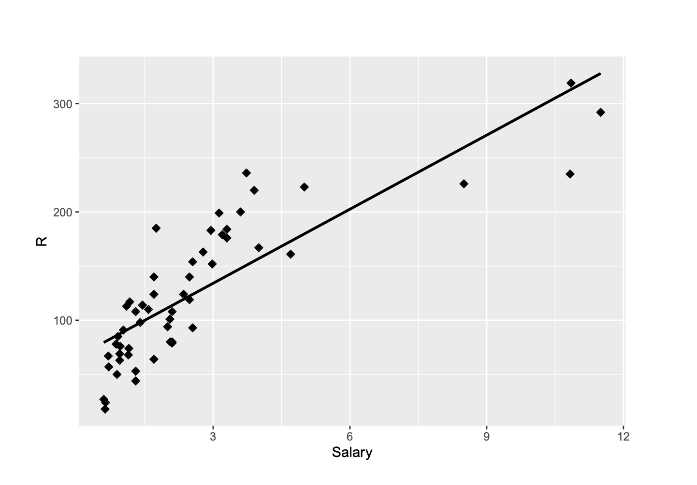
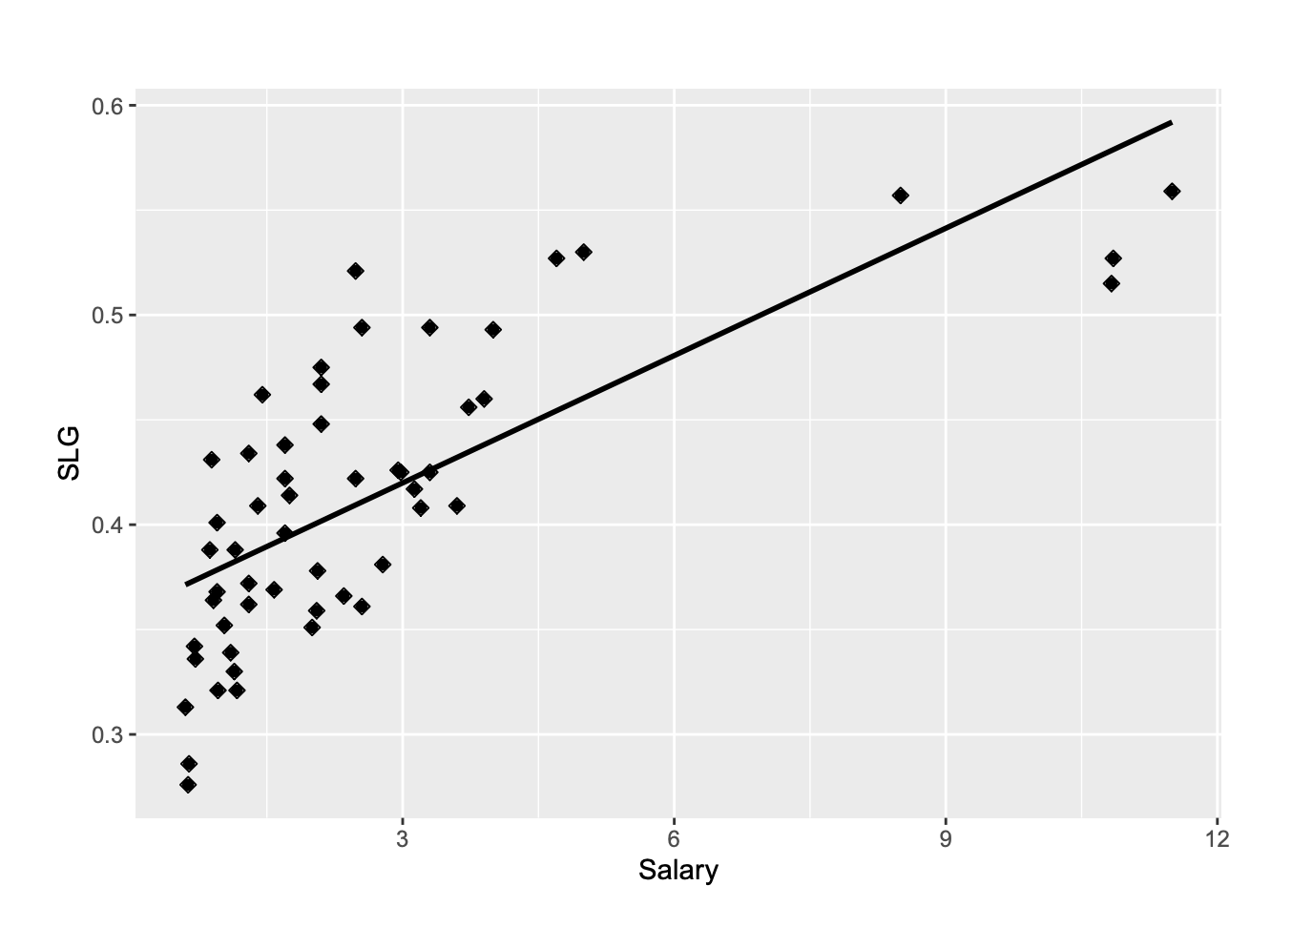
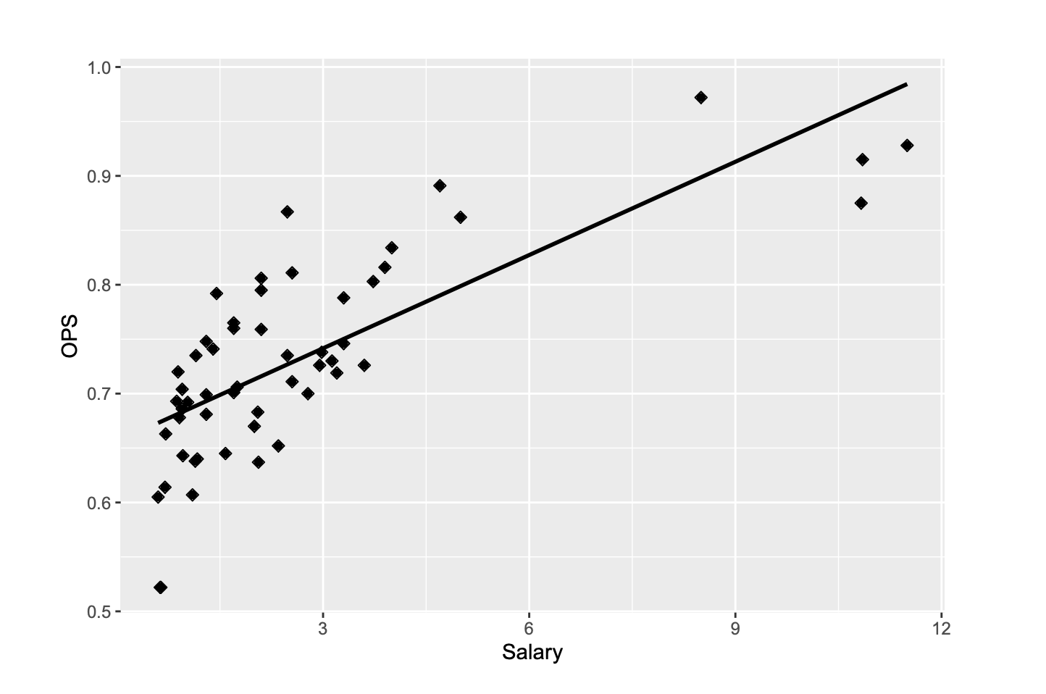
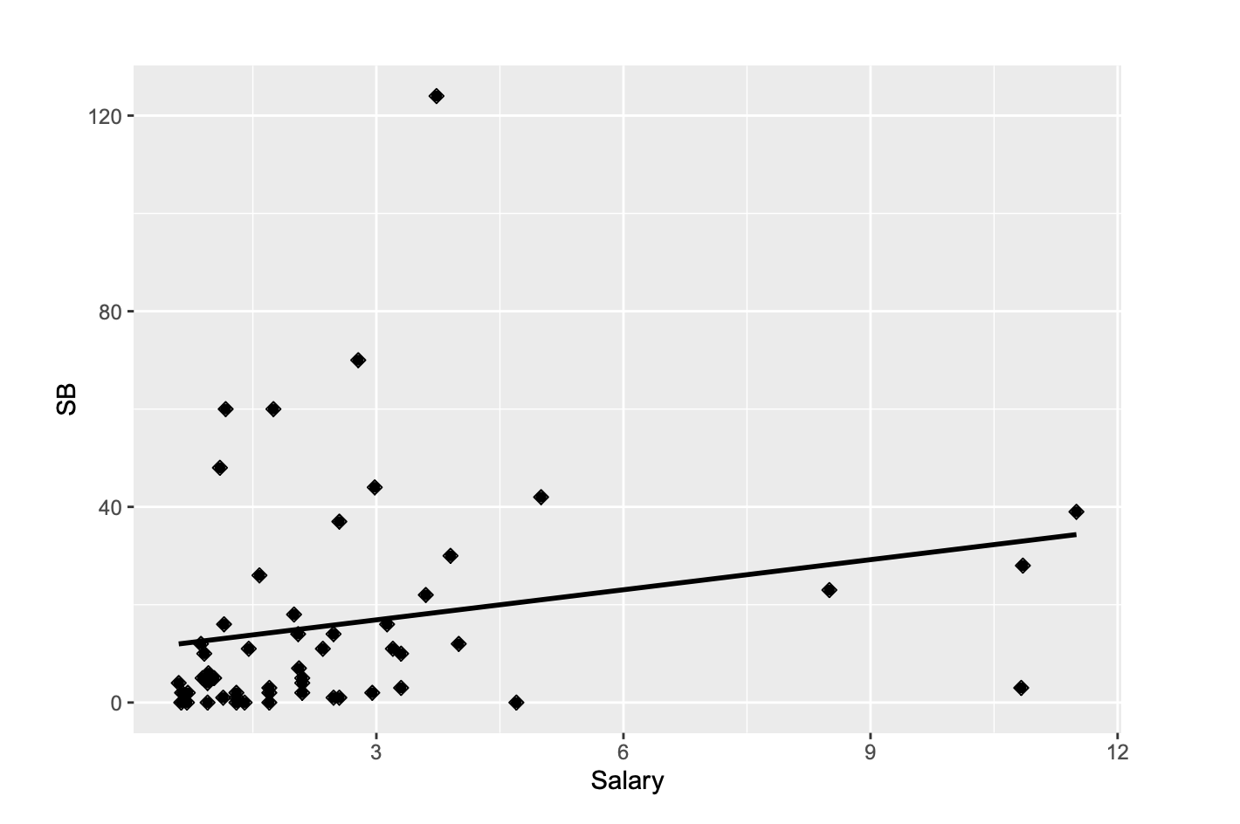
Salary vs...
R SLG
OPS SB

Slide 8
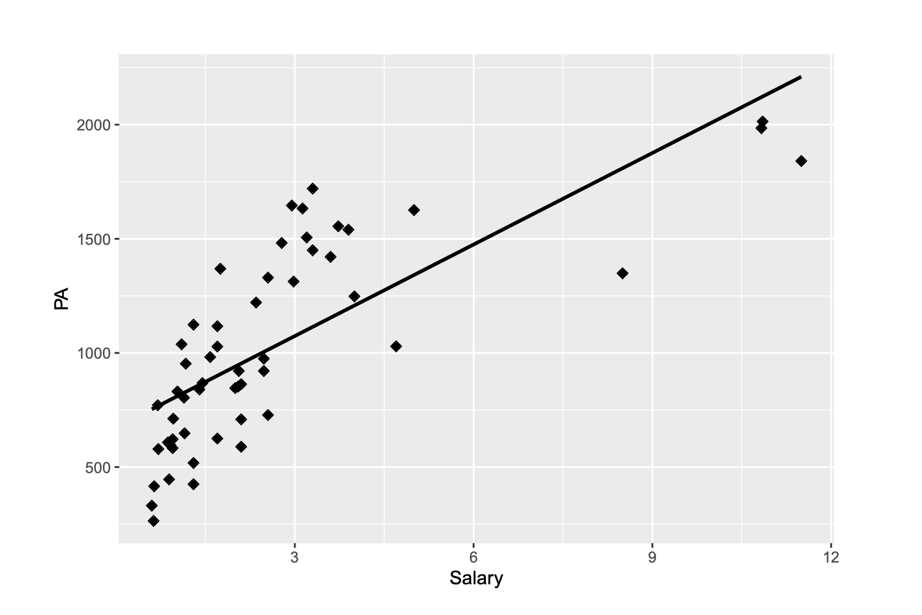
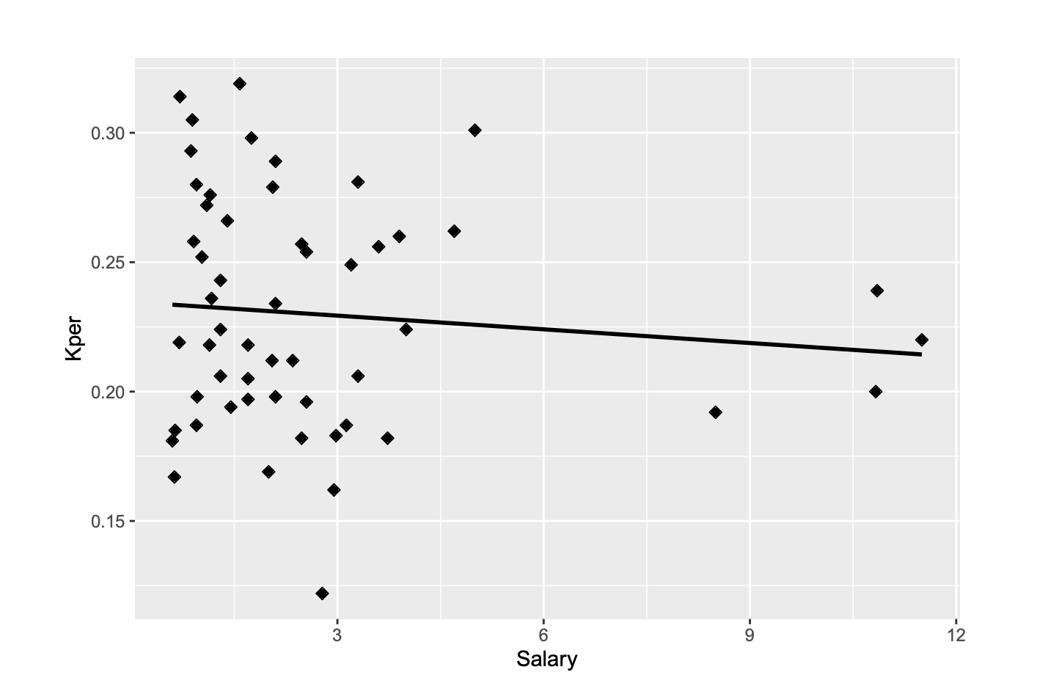
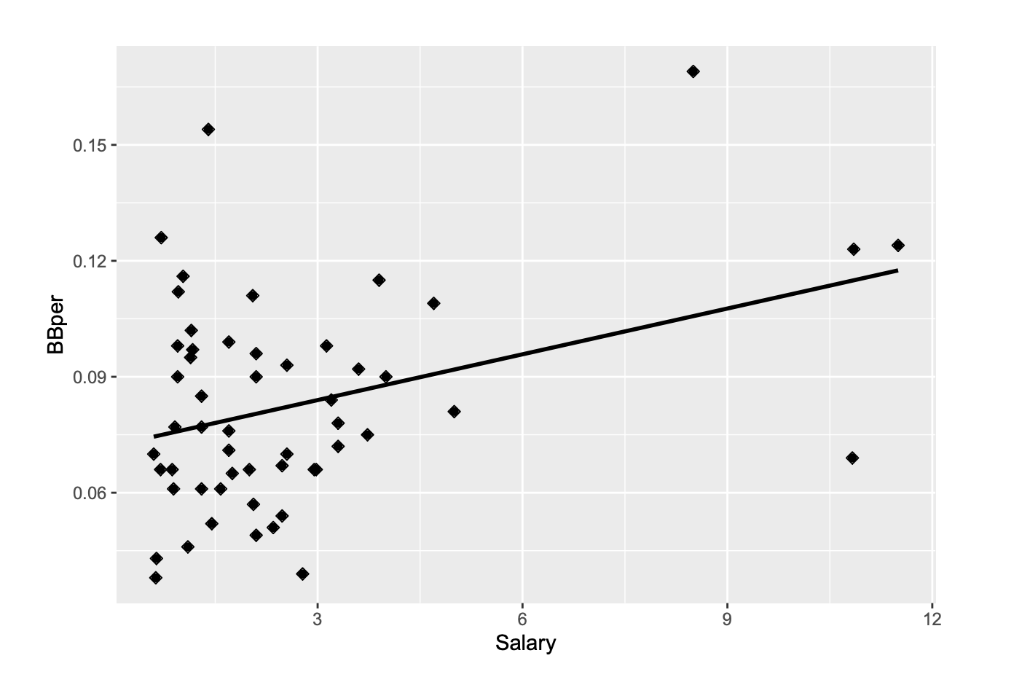
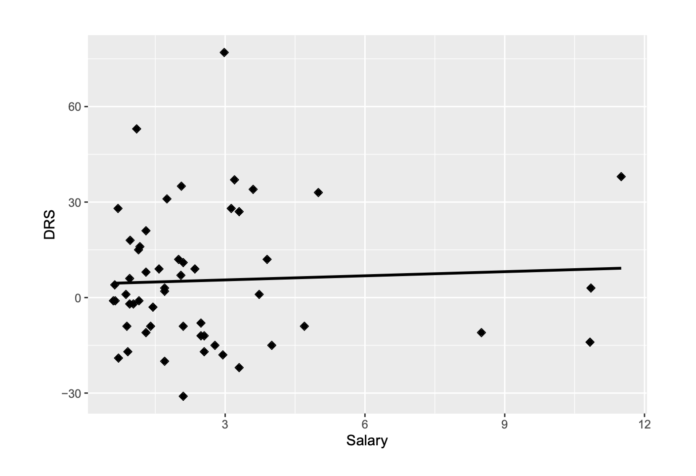
BA OBP
HR RBI
Salary vs...
PA Kper
BBper DRS
BA OBP
HR RBI

Slide 9
Variable Equation Adjusted R^2 R (correlation)
Batting avg vs salary | y=.0061x+.233 | .333 | .57706
OBP vs salary | y=.0083x+.2967 | .3903 | .6247
HR vs salary | y=9.0603x+9.7692 | .7151 | .8456
RBI vs salary | y=24.4347x+54.2666 | .7174 | .8470
Runs vs salary | y=22.7884x+65.8006 | .6947 | .8335
SLG vs salary | y=.0202x+.3592 | .5185 | .7201
OPS vs salary | .0286x+.6560 | .5644 | .7513
PA vs salary | 133.6658x+673.0660 | .5558 | .7455

Slide 10
P-values
Variable | p-value
BA | 2.91674*10^(-6)
OBP | 2.65889*10^(-7)
HR | 5.1998*10^(-16)
RBI | 4.19675*10^(-16)
R | 3.20004*10^(-15)
SLG | 5.07875*10^(-10)
Variable | p-value
OPS | 3.61482*10^(-11)
SB | 0.106251966
PA | 6.06771*10^(-11)
Kper | 0.48084081
BBper | 0.007878414
DRS | 0.713261653

Slide 11
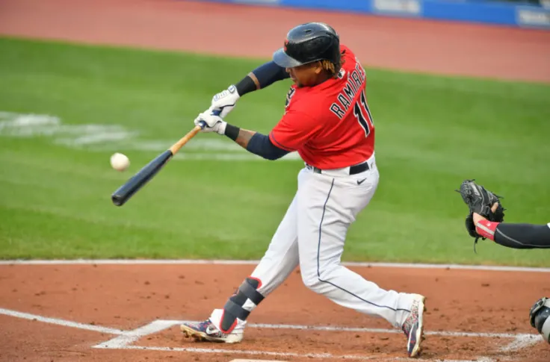
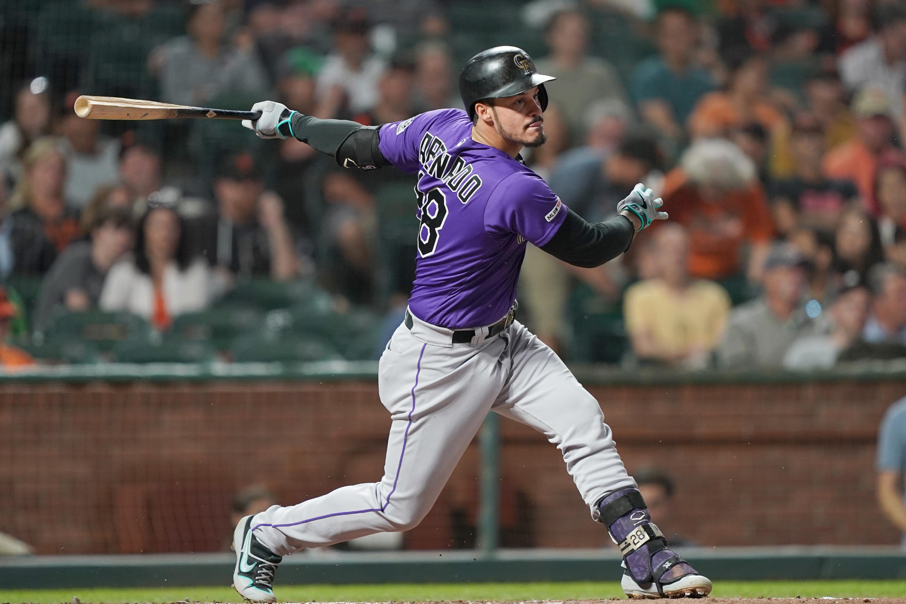
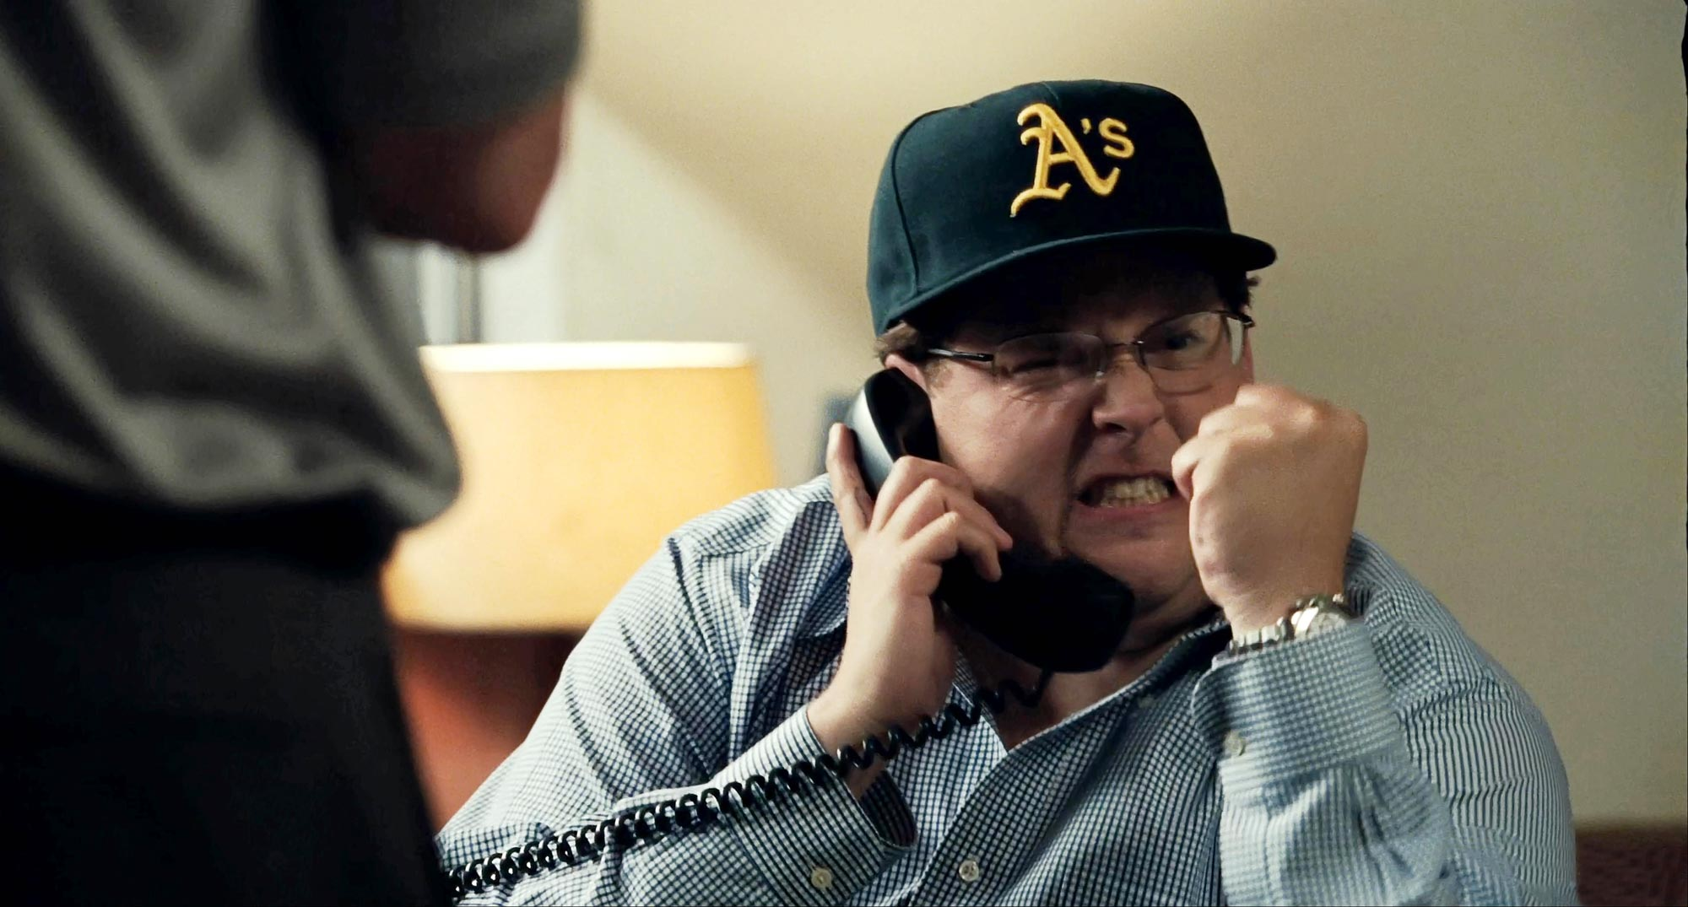
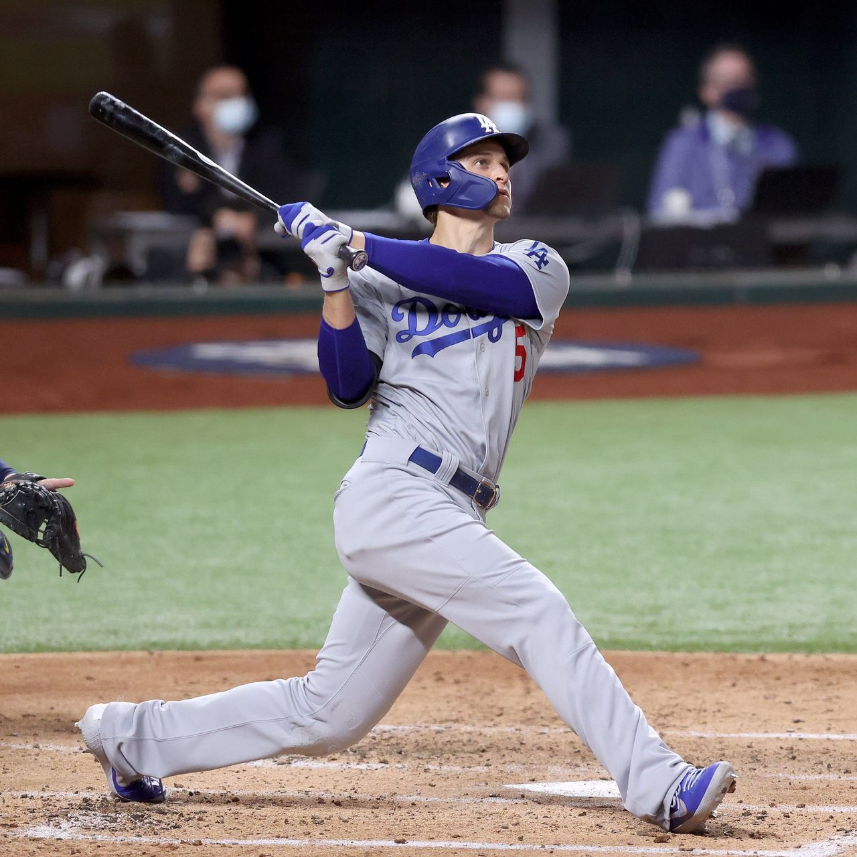
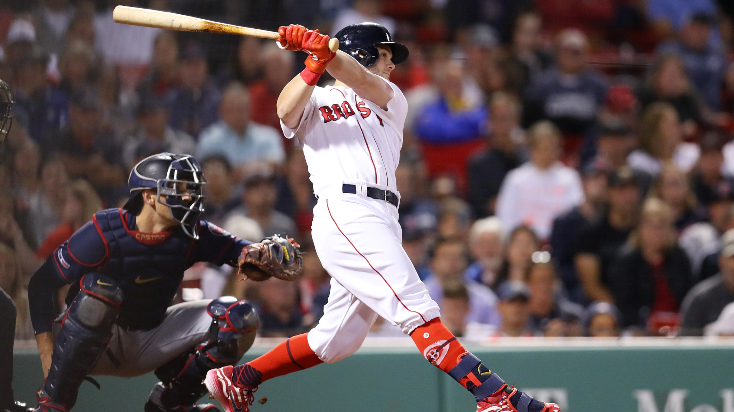
Questions?

